Slide 1
PyOhio 2015
Catching the bus on time --
Using Python, a Pebble Watch and (kind of) Open Data

Slide 2
Problem: Catching the Bus
I like to take the bus to work.
There are two bus lines that I can catch, Line 7 and Line 32.
I want to know when I need to leave the house to catch the bus!

Slide 3
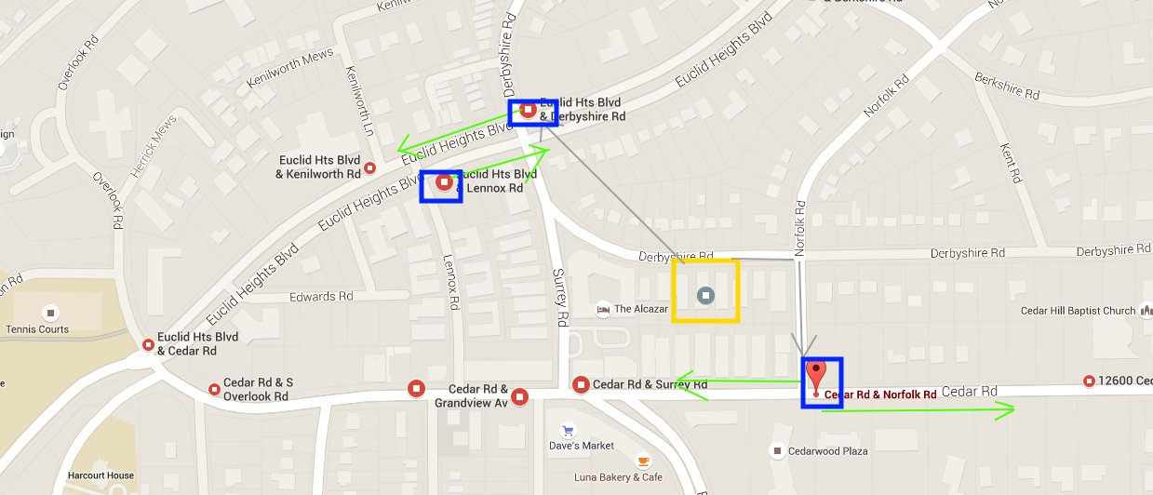
MAP!
Notes:
My house is squared in yellow. The grey lines represent my path to the bus stops. Bus stops are squared in blue and then the direction of the bus is a green arrow.
There are three bus stops – Cedar and Norfolk which servers bus line 32 and has a stop on each side of the street.
Then Euclid Hts and Derbyshire is served by bus 7 eastbound, and Euclid Hts and Lennox is served by bus 7 westbound.

Slide 4
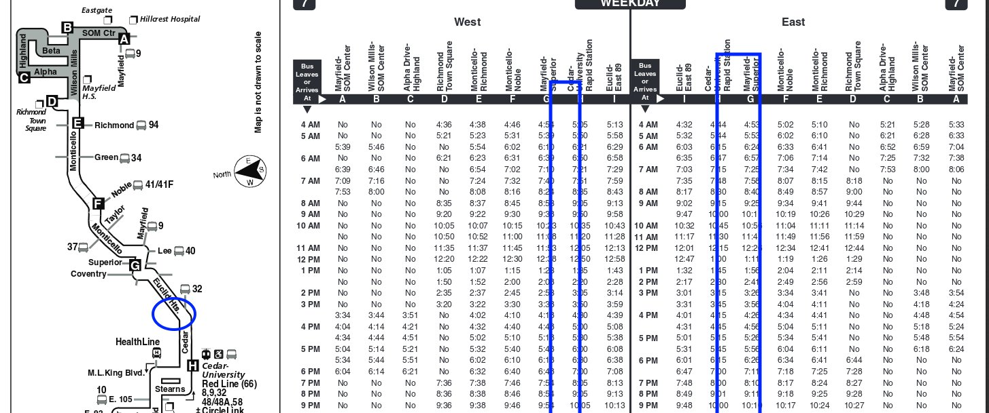
OK – so how do I actually get downtown
In the olden days, one would have to have a bus schedule! Here's what a bus schedule looks like:
Notes:
My stop is somewhere near the circle on the left hand side.
My stop times are somewhere in the 10 minutes between the two major stops marked with rectangles on the right.
Hard to actually figure out when I should be out there, right?

Slide 5
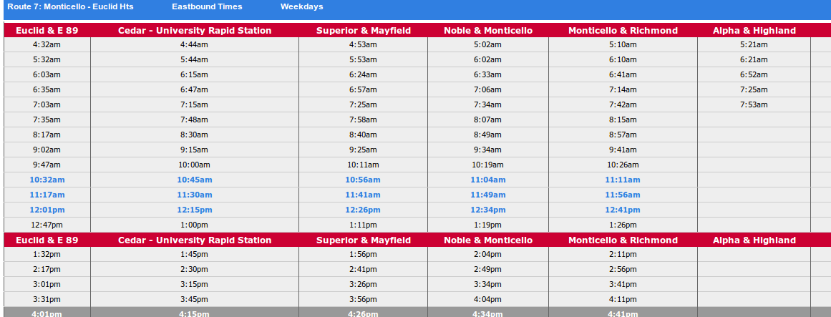
Come on, we have computers!
Ok, so shouldn't this be easier with technology? Here's what the HTML version of the time table looks like:
Notes:
So we get the same schedule as before, but at least now they highlighted the current time in blue. So I kind of have an idea of where I should be looking.
But this design does not make it real easy to figure out when my next bus is coming!

Slide 6
Where this fails:
(and part of the reason buses are unpopular)
For my specific stop, I don't have an exact time schedule.
The bus comes every 30 minutes during peak and every hour non peak.
If I miss a bus, I'm in trouble.
Or if something happens to the bus, I have no way of knowing.

Slide 7

For Instance:

Slide 8
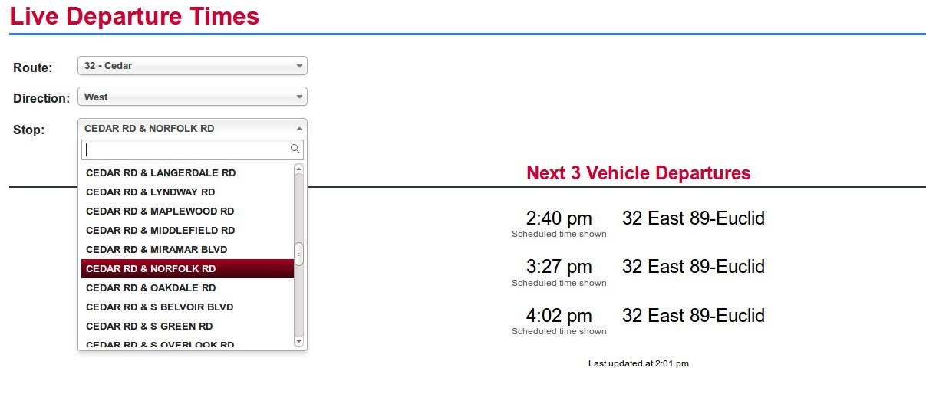
So how do we make it better?
Real time arrival times could help! In 2012, RTA (Cleveland's public transit operator) added GPS to all of their buses.
That means we should be able to get real time arrival time – let's see:
Notes:
A few things to call out:
All of those stops are listed only by their text – therefore I need to know exactly what stop I'm looking for.
Stops are not listed in bus order but in alphabetical order. This is good for finding, but if I select wrong, then I get a wrong time.
This page is not bookmarkable! Every time I want to see this stop I need to make all three selections. (behind the scenes, site is making an ajax POST request which we'll get to)

Slide 9
Actually catching the bus
So now I have an idea of when I actually need to leave the house. But maybe I'm waiting at the stop – can I look this info up on my phone?
Mobile enabled site – same problems (lots of bookmarks)
API :
As a turn-key, closed-source product, the vendor is under no obligation to provide a public API to the data, and does not, in fact, currently provide one. (source : http://www.urbanohio.com/forum2/index.php?topic=4504.8240;wap2)

Slide 10
Where we stand
Real time data – Positive!
RTA website works, but takes a while too look stuff up
Mobile enabled website works, but same problem as above
No public API – Negative :(

Slide 11

WWDTD
(what would Dick Tracy Do)
How cool would it be to be able to look up when the next bus arrives on our watch?
Notes:
Sidenote: are all modern inventions just trying to recreate the cool stuff on TV in the 60s and 70s like Star Trek Transponders and two way wrist tv walkie talkies?
Ok, Dick Tracy's watch has a two way radio and and TV – ours doesn't have TVs, but bluetooth is pretty much a two way radio between our phone and our watch, right?

Slide 12
Enter Python and the Pebble
We have tools that can help us solve this problem:
Python (to create our own API)
Pebble Watch (to act as our User Interface)

Slide 13
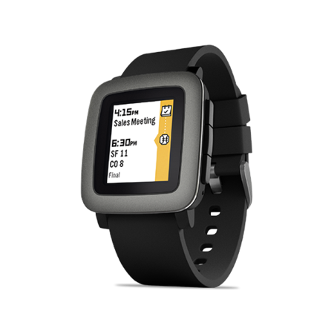
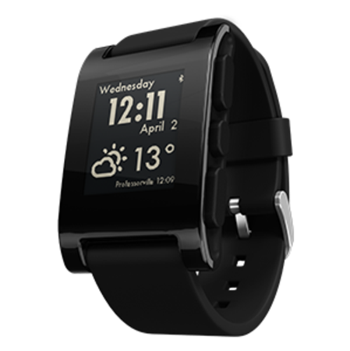
Pebble Watch
Developer Friendly
Not so expensive (~$90)
E ink display (so long battery time)
Notes:
We'll get back to Python, but let's talk about the Pebble watch.
The one on the left is the Pebble Time, which is pretty new and fancy and is in color.
I have the older one, the classic pebble which is black and white. As you can see in the image, the watch not only tells you the time, but can display pieces of information looked up on your phone and sent to the watch (like the weather)

Slide 14
Pebble Watch con't
Here's the plan:
We'll build an app on the Pebble Watch to let us know when the bus will arrive at the four nearest stops to my house
We'll create an API using Python to respond to requests from the watch
We'll create a database to store all of the stop data and routes and such. Then maybe we can see cool stuff like how often the bus is late

Slide 15
Step 1: Python Webapp
Here's what the python application should do:
Query the RTA website for predicted stop times for a given stop
Store the predicted stop times in some kind of database
Answer requests like this http://mybusapp.com/api/predicted_time?stop_id=1
with a blob of JSON for our watch app

Slide 16
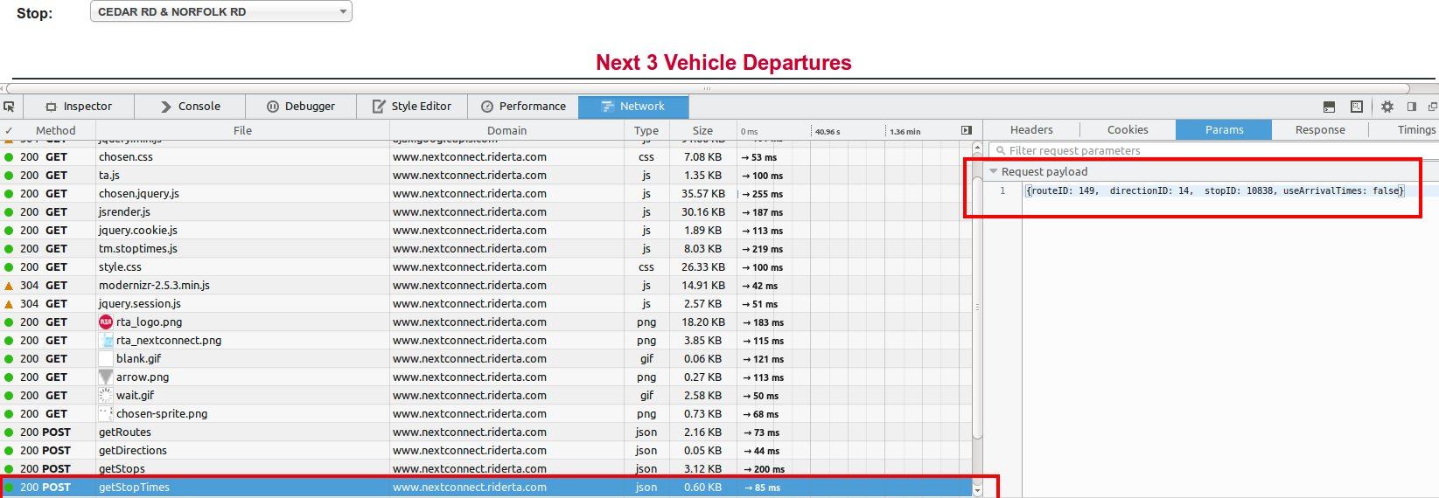
Figuring out how to get data from RTA website
Watch the requests:
Notes:
We see that the website has made a series of posts based on the selections in the html select boxes.
The final call is getStopTimes, which is posted to www.nextconnect.riderta.com/getStopTimes
The parameters, or payload, sent with this request is made up of a routeID, a directionID, a stopID and useArrivalTimes.
We'll need to find these values for each of the stops that we want to track. We can do that by watching how the params dictionary changes based on the stop and route changes we've made.

Slide 17
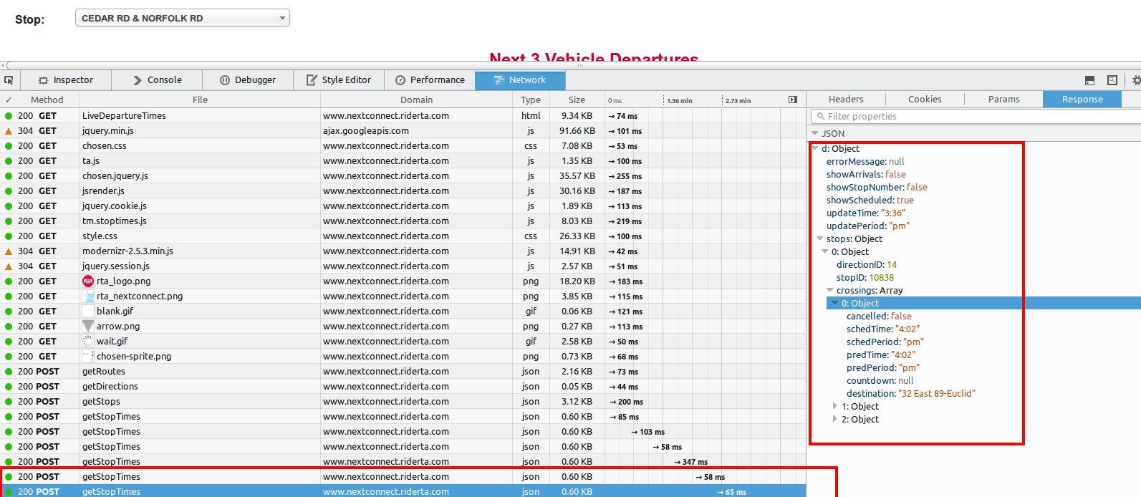
NextConnect Response
Analyze the JSON response
Notes:
So nextConnect returns a JSON dictionary, which is very nice. Now, if this request were a GET instead of a POST, we wouldn't have to do any further work.
Things to point out: crossings array contains both 'predTime' and 'schedTime'. Sometimes 'predTime' is null, in which case we're only viewing the scheduled Time

Slide 18
Getting data into Python
All code on github here: https://github.com/bormesh/buspebble
First – make POST request to get data from NextConnect
Use python module called requests http://docs.python-requests.org/en/latest/
Notes:
But since it's a post, we're not able to make AJAX calls across domains (from my local pebble watch to nextconnect.riderta domain.
Buuuut, we can make this call from a python web application

Slide 19
Python request
(/rtapebbletest/pg/stops.py)
Using requests, we can write something like this:
def look_up_rta_predictions(self):
  response = requests.post(
  'http://nextconnect.riderta.com/Arrivals.aspx/getStopTimes',
  data = '{"routeID": "%s","directionID":"%s","stopID":"%s", "useArrivalTimes":"false"}' \
  % (self.rta_internal_route_id, direction_id, self.rta_internal_stop_id),
  headers={'Content-Type': ' application/json'})
  crossings = response.json()['d']['stops'][0]['crossings']
Notes:
Make the request sending the parameters in the data keyword.
We expect a JSON response, so content type is json.
A request returns a response, and then we can use the json() property of the response to give back a python dictionary. Now we're able to get the same data back that we saw previously on the next connect website

Slide 20
Response
json_response = response.json()
{u'd': {u'errorMessage': None,
u'showArrivals': False,
u'showScheduled': True,
u'showStopNumber': False,
u'stops': [{u'crossings': [{u'cancelled': False,
u'countdown': None,
u'destination': u'7 Richmond',
u'predPeriod': None,
u'predTime': None,
u'schedPeriod': u'pm',
u'schedTime': u'8:04'}],
u'updatePeriod': u'pm',
u'updateTime': u'7:57'}}
Notes:
Using the json attribute on the response, we get the following dictionary back.
RTA may not have 'Open Data' in the sense of a public API, but by using the request module, we are able to get at the information we need in a format that we can use (json).
Utilizing python allows us to store the data or use it for our own devices.

Slide 21
Using the data
We can get the data, now what do we do with it?
Proxy
  As soon as we get a response on our api, then proxy the request through to NextConnect
Caching
  Use a database layer to store prediction times. Then API request will use database to return next closest prediction time
Caching is faster, but Proxy might be more accurate
Caching will allow for analyzing stops and performance

Slide 22
Database Tables
(tables found in rtapebbletest/database-schema-upgrades/make-routes-and-stops-table.sql)
Routes Table:
create table routes
(
  route_id serial primary key,
  rta_internal_route_id integer not null,
  title citext,
  description text,
  inserted timestamp not null default now(),
  updated timestamp
);
insert into routes
(title, rta_internal_route_id)
values
('32 Cedar Road', 149),
('7 Euclid Heights', 103);
Notes:
For this project, I chose a the caching option. That means, we'll create our own internal database, and store routes, stops, and predicted stop times internally. This duplicates what NextConnect already has, but also gives us a little bit more flexibility when it comes to analyzing the data as well as speed when it comes to making a request through the API (we simply do a database lookup).

Slide 23
Database Tables
(tables found in rtapebbletest/database-schema-upgrades/make-routes-and-stops-table.sql)
Destinations Table:
create table destinations
(
  destination citext primary key,
  inserted timestamp not null default now(),
  updated timestamp
);
insert into destinations
(destination)
values
('Richmond'),
('Montefiore'),
('East 89th-Euclid');
Notes:
Destinations – the direction and ending point of the bus

Slide 24
Database Tables
(tables found in rtapebbletest/database-schema-upgrades/make-routes-and-stops-table.sql)
Stops Table:
create table stops
(
  stop_id serial primary key,
  rta_internal_stop_id integer not null,
  title citext,
  route_id integer not null references routes(route_id),
  destination citext not null references
  destinations (destination),
  inserted timestamp not null default now(),
  updated timestamp
);
insert into stops
(rta_internal_stop_id, title, destination, route_id)
values
(9411, 'EUCLID HTS BLVD & DERBYSHIRE RD', 'East 89th-Euclid', (select route_id from routes where rta_internal_route_id = 103)),
(9405, 'EUCLID HTS BLVD & LENNOX RD', 'Richmond', (select route_id from routes where rta_internal_route_id = 103));
Notes:
Stops – these are important as these are the data point that we'll tie a predicted time to. Also, in the real world, this stop represents the location I'll physically need to travel to to catch the bus.

Slide 25
Database Tables
(tables found in rtapebbletest/database-schema-upgrades/make-routes-and-stops-table.sql)
Stops Table:
create table scheduled_stops
(
  stop_id integer references stops (stop_id),
  scheduled_stop_time timetz not null,
  primary key (stop_id, scheduled_stop_time),
  inserted timestamp not null default now(),
  updated timestamp
);
And finally:
create table predicted_stop_times
(
  predicted_stop_id serial primary key,
  stop_id integer not null,
  scheduled_stop_time timetz not null,
  foreign key (stop_id, scheduled_stop_time)
  references scheduled_stops (stop_id, scheduled_stop_time),
  predicted_stop_time timetz not null,
  inserted timestamp not null default now(),
  updated timestamp
);
Notes:
Scheduled Stops – when the bus is supposed to actually arrive at the stop – when we don't have a prediction, we'll have to fall back to this.
Each predicted time also returns a scheduled time – I'm lazy, so I'm not going to go search for the buses schedule, I'll just add a scheduled time as soon as I get one in my response.
Danger – weekend schedules are different from weekday schedules – I don't account for this

Slide 26
Start filling our database
Now that we have a DB schema, we can actually start adding data to it!
A good way to do this is with a python script. That way I can add it to a cron job later and automatically check the stops.
Quick side note – if you haven't run into using psycopg2's register composite feature, you should check it out. It allows us to take a database table and transform it into a python class when it's returned from a query. That let's us do something like this:
cursor.execute(select (s.*)::stops as stop from stops where stop_id = 1)
s = cursor.fetchone().stop
The variable s now points at a python object. Then we can do fun stuff like:
s.look_up_rta_predictions()

Slide 27
Putting it together
(rtapebbletest/scripts/check_prediction_times.py)
Important part of script:
stops = stops.Stop.all_stops(pgconn)
log.debug("Found {0} stops to check".format(len(stops)))
for stop in stops:
  log.debug("Now checking stop times for {0}".format(stop))
  try:
    stop.check_and_insert_stop_predictions(pgconn)
  except Exception as e:
    log.error(e)
    pgconn.rollback()
    continue
  finally:
    pgconn.commit()
log.debug("Stop checking completed")
Notes:
Here's a python script that will grab all the stops currently in our database, ask NextConnect for their predictions for each stop, and then store each stops predictions in our database.

Slide 28
Automate it
OK, we're almost there.
I want to install this on a server and have it run every minute or every two minutes so I have up to date predictions.
I have few enough stops that this call can be completed quickly (but checking all of the stops even for a single route might take a little longer)
Here's my cron job (type 'crontab -e' in linux to edit your user's cron job's)
*/1 * * * * /home/rtapebbletest/.virtualenvs/buspebble/bin/python /home/rtapebbletest/checkouts/buspebble/rtapebbletest/scripts/check_prediction_times.py prod.yaml
Notes:
Once we've installed the cron job, then we'll begin to see our database fill with bus schedule data.

Slide 29
On to the Python API
For the simplest scenario, we'll need a webapp that can handle one request with one argument:
ourapi.com/api/prediction?stop=
where the stop arguments takes a numerical id
We'll use horsemeat for our web framework, which runs a gunicorn webapp and everything sits on top of apache. The whole stack could be another talk, so we'll gloss over the details and get to what the handler should look like in our frameworks context.

Slide 30
Handler
(rtapebbletest/webapp/rtapebbletest/handlers.py)
def handle(self, req):
stop_id = req.wz_req.args.get("stop", 0)
pgconn = self.cw.get_pgconn()
stop = stops.Stop.by_stop_id(pgconn, stop_id)
prediction, scheduled = stop.get_my_next_predicted_stop_time(pgconn)
if not prediction:
prediction = ''
scheduled = stop.get_my_next_scheduled_stop_time(pgconn)
now = datetime.datetime.now(scheduled.tzinfo)
scheduled_dt = datetime.datetime.combine(datetime.datetime.now(),
scheduled)
minutes_until_bus = (scheduled_dt - now).seconds / 60
else:
now = datetime.datetime.now(prediction.tzinfo)
prediction_dt = datetime.datetime.combine(datetime.datetime.now(),
prediction)
minutes_until_bus = (prediction_dt - now).seconds / 60
prediction = prediction.strftime("%H:%M")
scheduled = scheduled.strftime("%H:%M")
return Response.json(dict(
reply_timestamp=datetime.datetime.now(), message="Returning stops for
{0}.".format(stop_id),
success=True,
minutes_until_bus =
minutes_until_bus,
prediction=prediction,
scheduled=scheduled))
Notes:
Input is the stop id.
We parse our requests arguments for the stop id, and then look up in our database the stop.
Then, we grab the next closest predicted and scheduled time.
If predicted time is null, then we return just the scheduled time.
Finally, as we'll see later, we need to format the response in python, as it's hard to do in javascript on the watch.
Output is a JSON dictionary

Slide 31
Response from API
{
"message": "Returning stops for 1.",
"minutes_until_bus": 28,
"prediction": "23:01",
"reply_timestamp": "2015-07-31T22:32:41.296783",
"scheduled": "23:01",
"success": true
}

Slide 32
Enter: The Pebble Watch
The pebble watch functions like a simplified browser display screen
2 options: download SDK and compile C++ on your own box and install on phone or
Use Cloud Pebble: Pebble's web based development solution. Use javascript and custom libraries written by Pebble.
For this tutorial I used Cloud Pebble – very easy to get running.

Slide 33
Cloud Pebble
Create an account (https://cloudpebble.net) .
Once you're in, the main file of execution will be app.js.
Simply place watch app creation code in app.js and hit compile!
In order to start testing any of the code created in Cloud Pebble, you'll have to do this first:
Enable the developer connection on your phone:
  http://developer.getpebble.com/guides/publishing-tools/developer-connection/
Note, the phone must be connected to wifi -- I was not able to test on the phone without wifi enabled.
Make sure you have enough open app slots left on the phone!

Slide 34
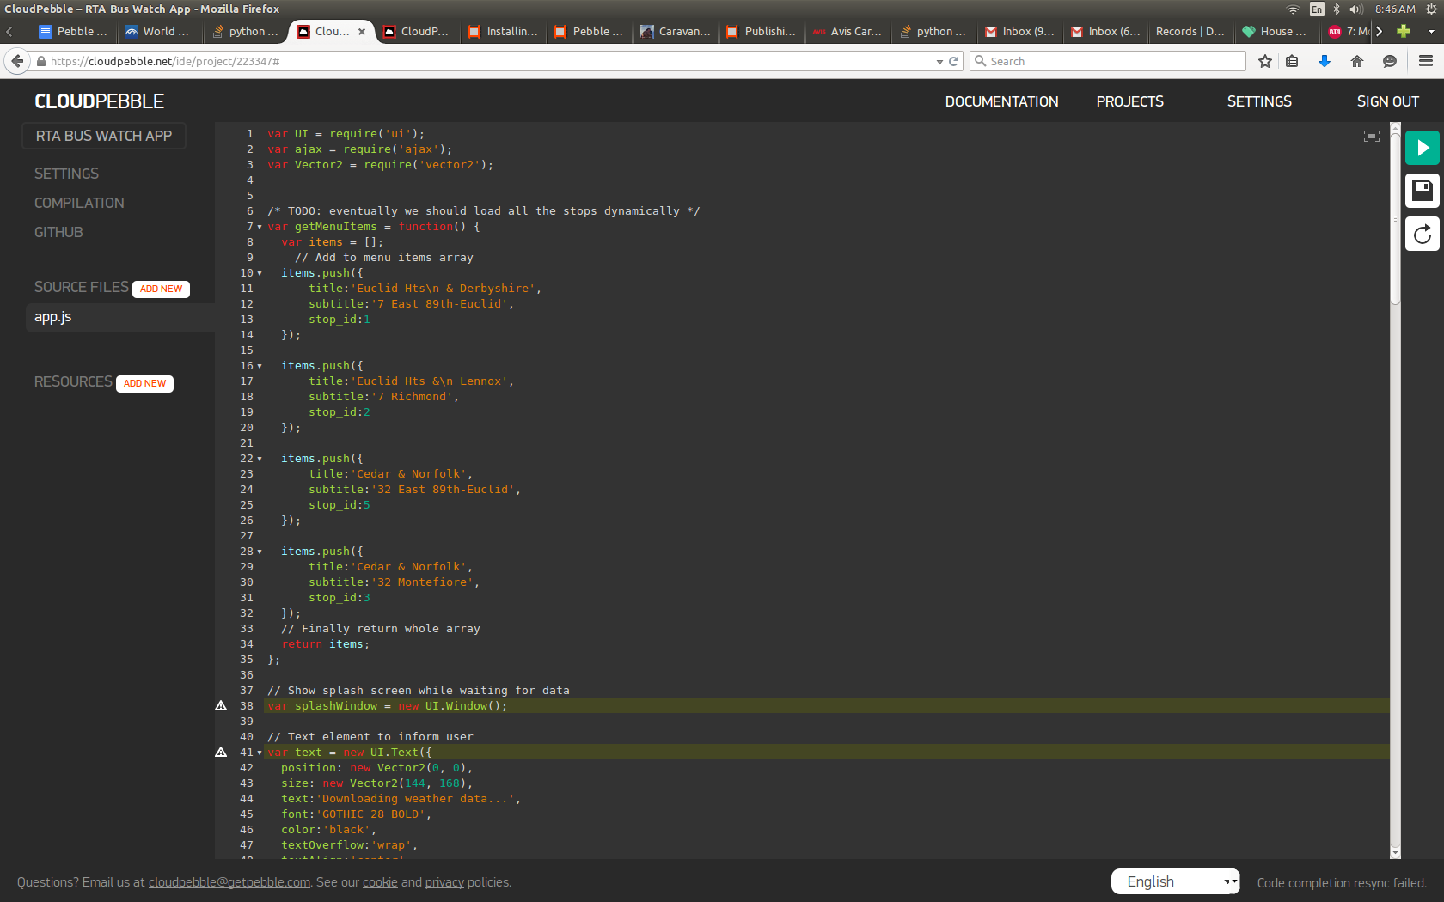

Slide 35
App.js
Pebble uses require to import libraries.
  require('ui') – we'll use this library to create menus
  require('ajax') – we'll use this library to call out to our api
Our pebble app will be made up of Menu Items for stops, and then an ajax call to get the next predicted stop time.

Slide 36
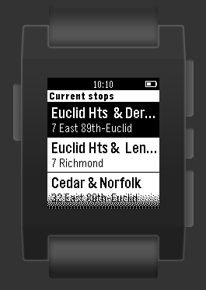
Create a Menu and Display
var stopsMenu = new UI.Menu({
sections: [{
title: 'Current stops',
items: [{title:'Euclid Hts & Derbyshire',
'subtitle': '7 East-89th-Euclid',stop_id:1
}]
});
Display it:
  stopsMenu.show()

Slide 37
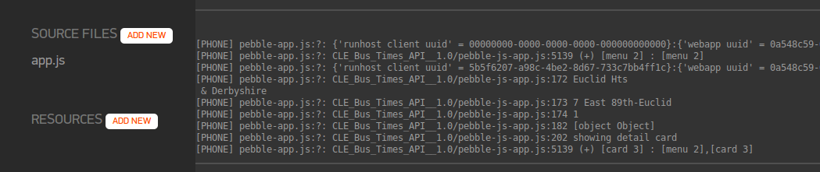
Select a Menu Item
MenuItem has an select function which fires when item is selected. We should do our ajax call when this happens
stopsMenu.on('select', function(e) {
console.log(menuItems[e.itemIndex].title);
console.log(menuItems[e.itemIndex].subtitle);
console.log(menuItems[e.itemIndex].stop_id);
var stop_id = menuItems[e.itemIndex].stop_id;
ajax(
{

Slide 38
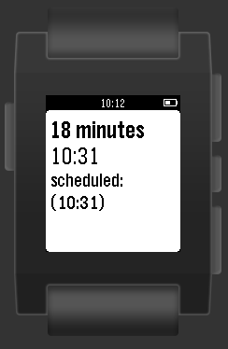
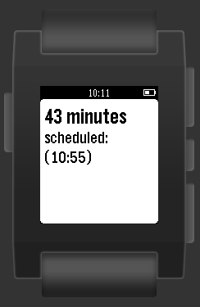
Ajax just like in a webapp
ajax(
{
url:'http://busapp.com/api/prediction?stop=' + stop_id ,
type:'json'
},
function(data) {
console.log(data);
var subtitle = '';
var content = '';
if (data['predicted'] !== null)
{
subtitle = data['prediction'];
content= 'scheduled: (' + data['scheduled'] + ')';
}
else
{
subtitle = data['scheduled'];
content= 'no prediction available, showing scheduled';
}
var detailCard = new UI.Card({
title:data['minutes_until_bus'] + ' minutes',
subtitle:subtitle,
body:content
});
console.log('showing detail card', detailCard);
detailCard.show();
},
function(error) {
console.log('Ajax Call failed: ' + error);
}
);

Slide 39
So we've done it
Phone must be on and bluetooth connected!
Dick Tracy would be proud!

Slide 40
Some analytics
Longest wait by stop and schedule
select stop_id, scheduled_stop_time,
max(predicted_stop_time::time - scheduled_stop_time::time)
from predicted_stop_times
group by scheduled_stop_time, stop_id
order by max desc;
Live demo here?

Slide 41
Questions / Comments?
Project link – make it better if you want!
https://github.com/bormesh/buspebble
Give me Pheed Back!
  http://plp.io/pyohio/#cchc

